Slide 1

Cannabis Stock Price Prediction
Mark Kipper
Data Science Capstone Project, August 2, 2021 Cohort

Slide 2

The question
Can the next day’s price of certain cannabis stocks be reasonably predicted?

Slide 3
The Reason
Cannabis used to be illegal in the United States.
In 2012, Colorado and Washington state were the first 2 states to legalize Cannabis for recreational use.
Since then, the industry has thrived.
Investors in these companies have seen their stock prices rise similar to the dot com bubble of the late 1990s.
This should, in no way, be considered sound financial advice and this model should not be used with the hope of realistically striking it rich in the market.

Slide 4

Data
I used 10 of the top performing cannabis stocks, 5 cannabis ETFs, and the Dow Jones Industrial average
CGC – Canopy Growth Corporation
CRLBF – Cresco Labs Inc
CRON – Cronos Group Inc
CURLF – Curaleaf Holdings Inc
GTBIF – Green Thumb Industries Inc
IIPR – Innovative Industrial Properties Inc
TCNNF – Trulieve Cannabis Corp
TLRY – Tilray Brands Inc
TRSSF – TerrAscend Corp
VRNOF – Verano Holdings Corp
MJ – ETFMG Alternative Harvest ETF
MSOS – AdvisorShares Pure US Cannabis ETF
YOLO – AdvisorShares Pure Cannabis ETF
CNBS – Amplify Growth Opportunities ETF
THCX – The Cannabis ETF
DJIX – Dow Jones Industrial Average (^DJI)
Historical stock performance for all stocks in this project was downloaded from Yahoo! Finance.

Slide 5
Features
For each stock, I set the timestamp as the index
I then added some new features to the dataframe:
I shifted the data so that I could get the previous close price as well as the next day’s closing price (target variable).
I added a column for the difference in price for each day and the % change for each day.
I added 5 day and 10 day rolling averages.
I decomposed the date time index and added month, day, year, and quarter columns.
Finally, I drop the “Adjusted Close” column.

Slide 6
Features
Because there are some stocks that are older than others, when I merge them together, I am often left with many rows of N/A values.
In these cases, I create an isna() dataframe.
Unfortunately, this also duplicates all the column names, so I add a suffix to the duplicates.
I fill the N/As from the original dataframe with zeroes and concatenate them both.

Slide 7

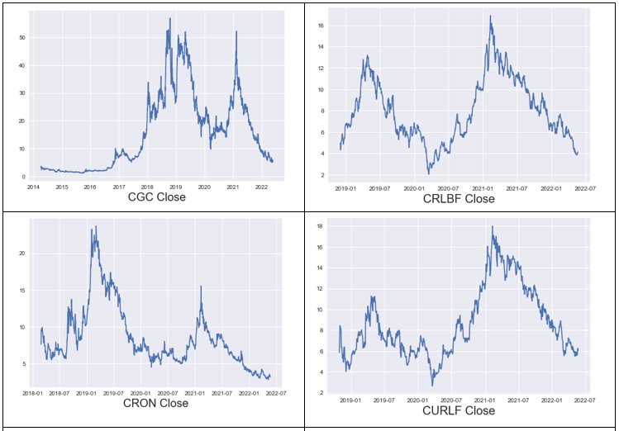
EDA
I plotted the close of each of the 10 stocks to visualize the data.

Slide 8
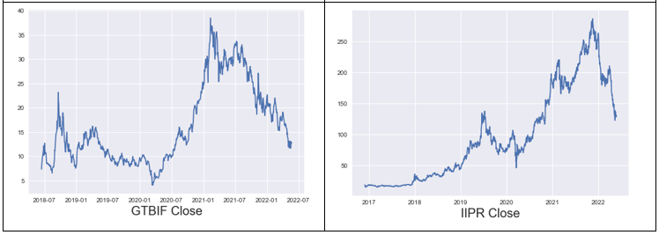
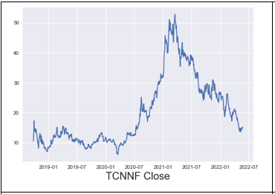
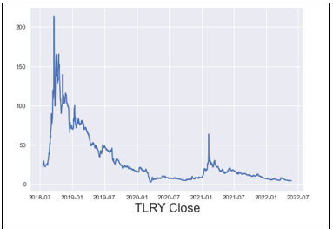
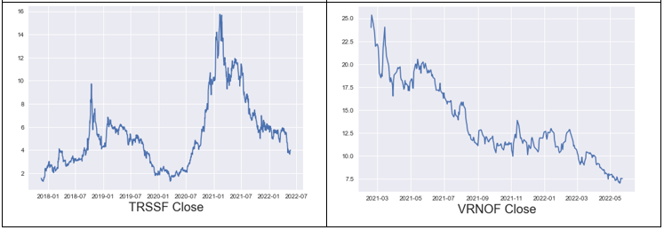
EDA

Slide 9

Model Selection
I am using a linear regression model exclusively.
My focus rather, is the feature combinations which will give me the best result.
I have outlined 7 different linear regression models:
Target stock + Dow Jones Industrial Average (Dow)
Target stock + all 5 ETFs
Target stock + ETFs + Dow
Target stock + remaining 9 stocks
Target stock + remaining 9 stocks + Dow
Target stock + remaining 9 stocks + ETFs
Target stock + remaining 9 stocks + ETFs + Dow
With 10 cannabis stocks, I ran these models 10 times in the above combinations.

Slide 10
Model Selection
Each model only used as many dates as were available in the target stock.
90/10 split for training and testing.
The models were scored using root mean squared error (rmse).
Each stock was run through the seven combinations and the rmse was recorded for each in a hyper table.
The lowest rmse is understood as the best performing model in this analysis.
The hyper table was sorted by rmse and only the top performer was saved.
These were gathered into a final hyper table to see which of the seven combinations performed best for each target stock.

Slide 11
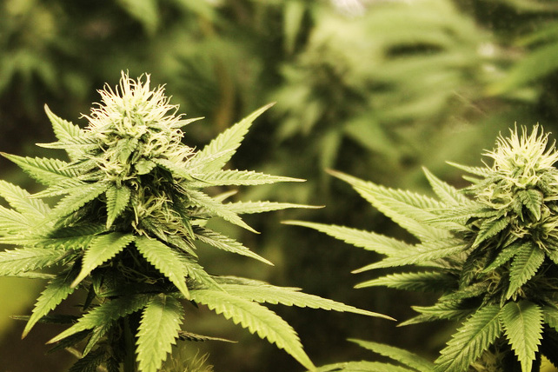
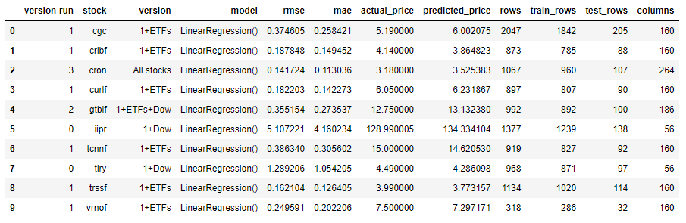
Results

Slide 12

Results
Using the results of the hyper table, I ran a basic simulation of hypothetical trades using my model on the best performing combination of explanatory variables for each target stock.
The premise for the simulation is: if the predicted closing price is greater than the actual Open price, then we sell 100 shares at the actual Closing price.
The sum of all the trades made, based on these criteria, is given.
The following slides include the plots for the best performing model run for each stock along with the simulation gains based on the model.

Slide 13
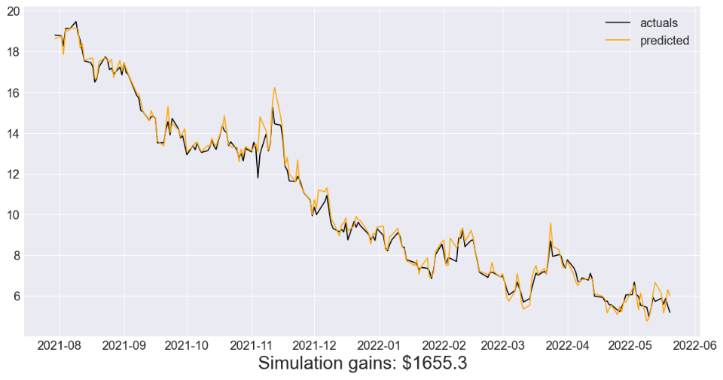
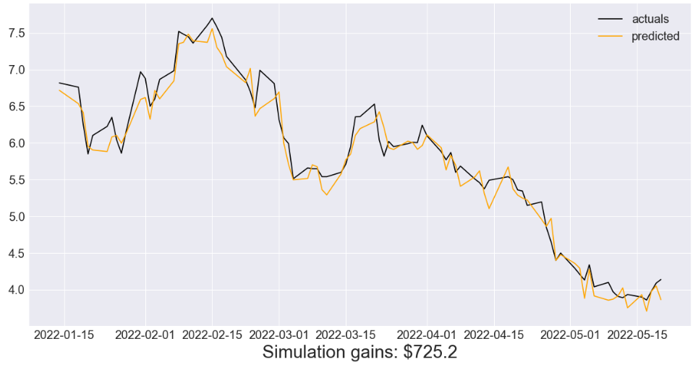
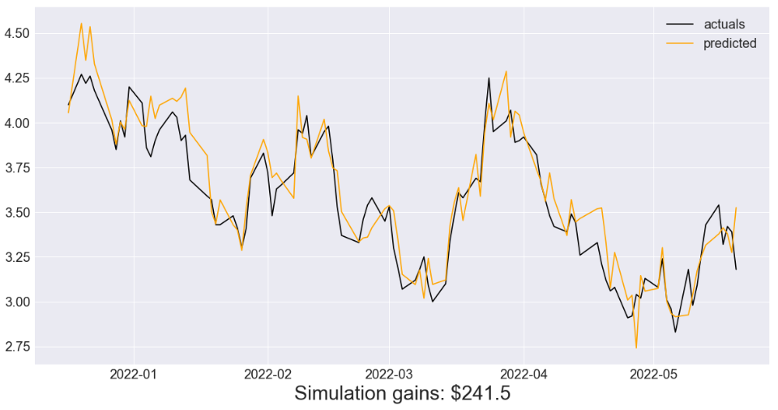
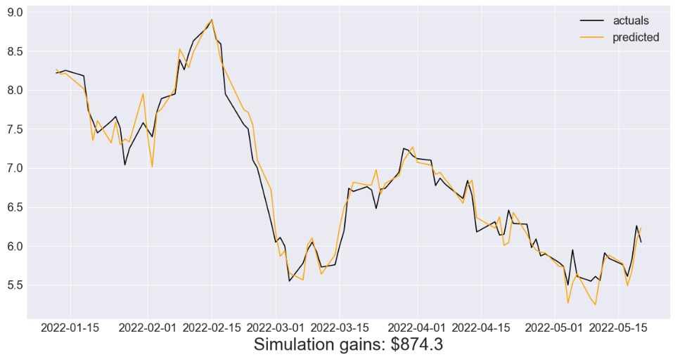
Results
CGC | CRLBF
CRON | CURLF

Slide 14
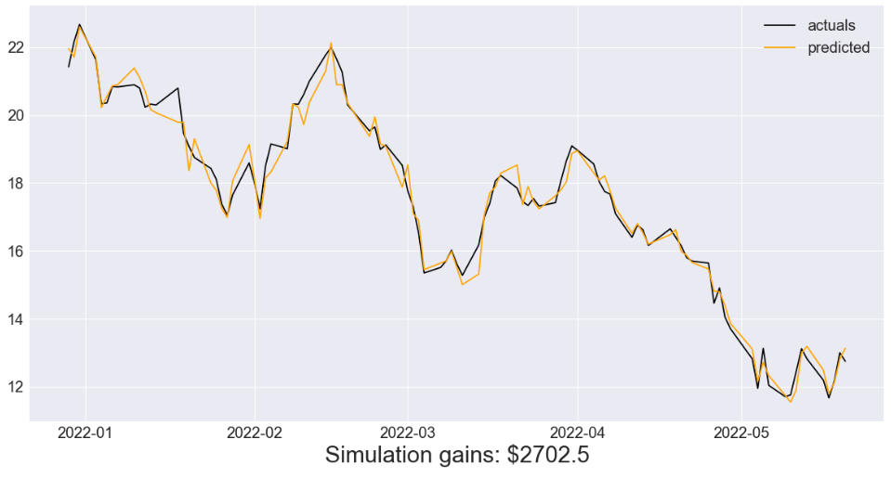
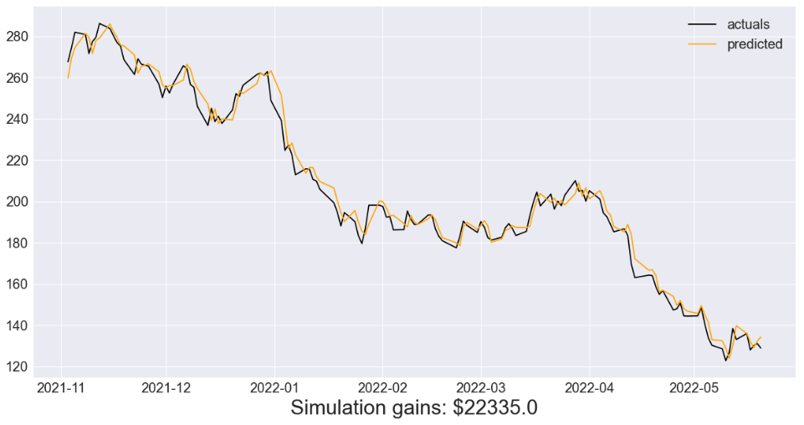
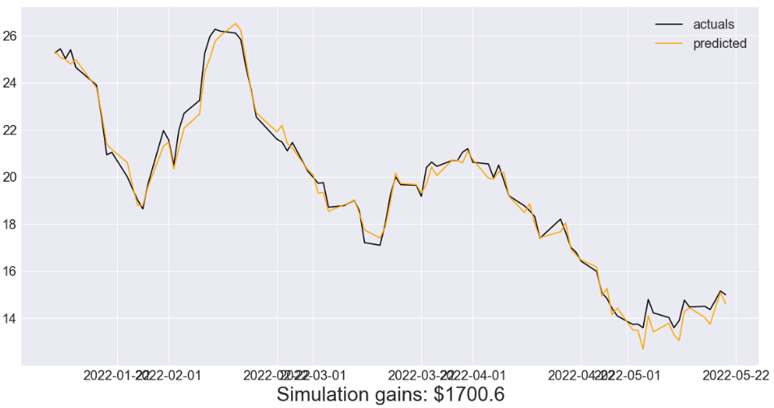
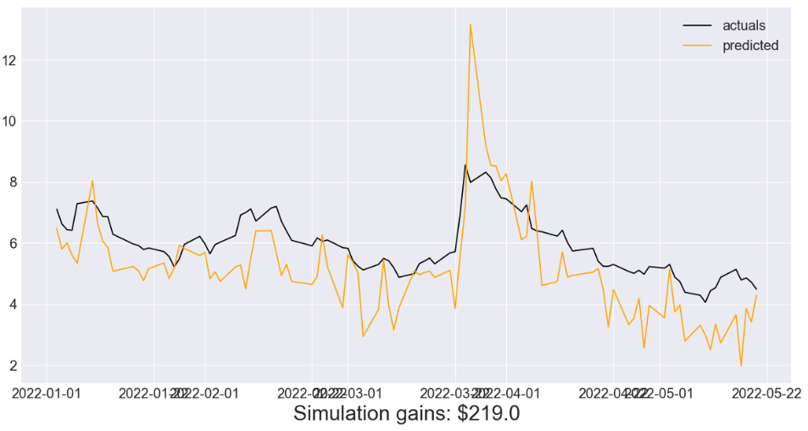
Results
GTBIF | IIPR
TCNNF | TLRY

Slide 15
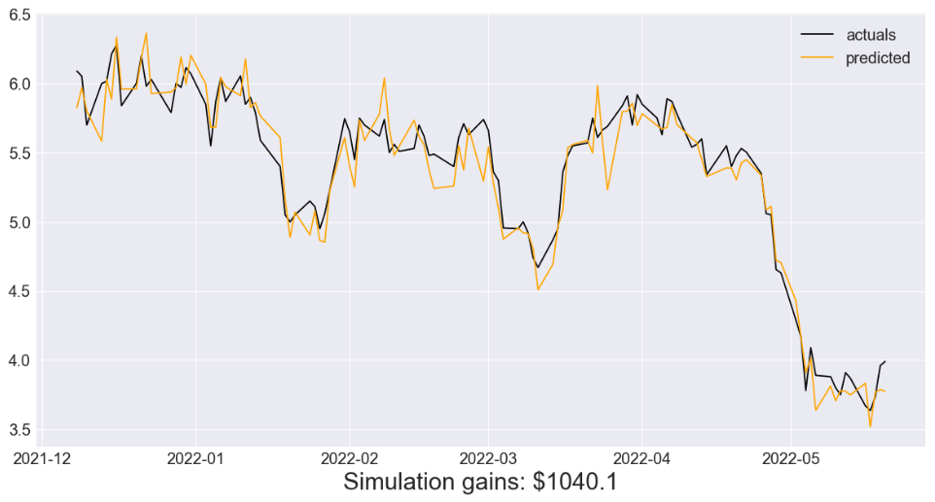
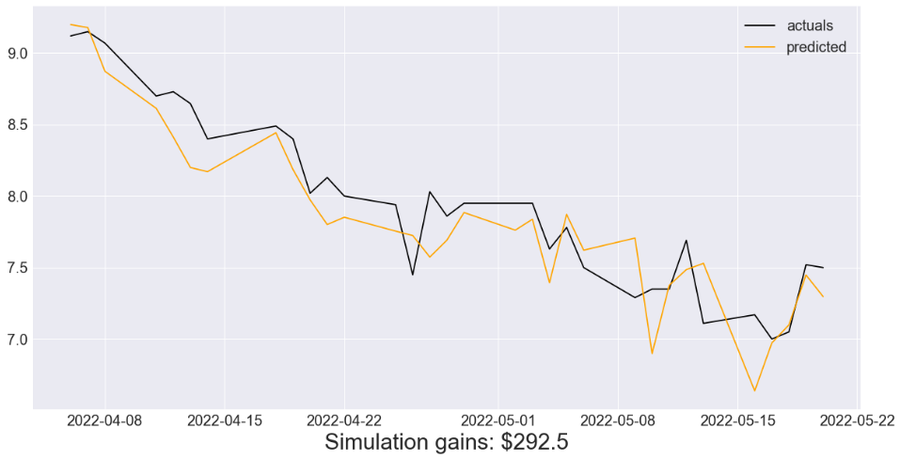
Results
TRSSF | VRNOF
The total gains using just these 10 cannabis stocks and my basic simulation yields $31,786.00.

Slide 16

Future Work
I would like to perform these predictions using ARIMA models, LSTM neural networks, or both methods to compare the results.
Although my focus was the combination of explanatory variables that can be included in the multiple regression model to yield the best results, there are other regression models available.
I would have liked to include a ‘Buy’ simulation, but to be consistent with the ‘Sell’ simulation, I would have to re-run the models using the ‘next_Open’ target variable for all stocks.

